Slide 1
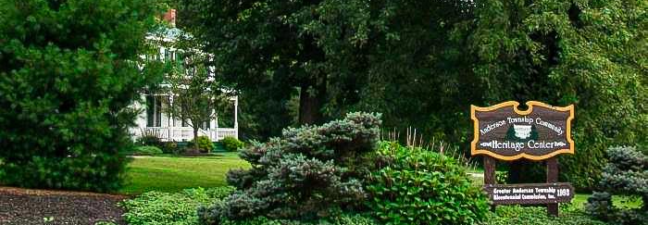
Heritage Arboretum Development Project
GROUP-1
Bothsa, Indrani
Saraswat, Gaurav
RECORDING LINK
Singh, Neha
Wadhwa, Vaishnavi Gopal
08-03-2024

Slide 2
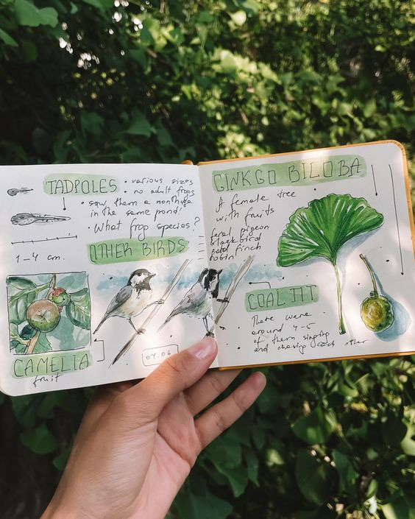
AGENDA
Key Findings
Reflect on the Agile Process
Discuss Challenges and Solutions
Team Collaboration and Individual Contributions
Evaluate Project Goals
Future Recommendations
Conclusion & Closure

Slide 3
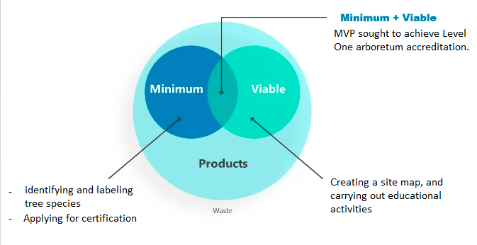
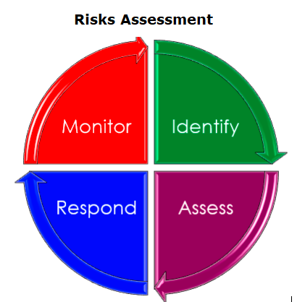
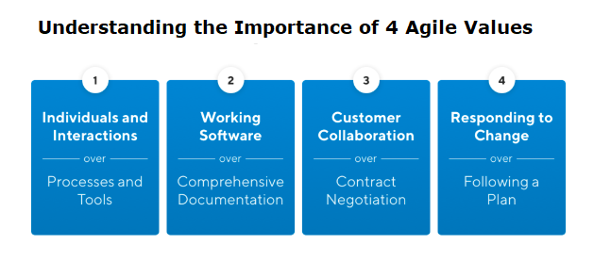
Key Findings

Slide 4


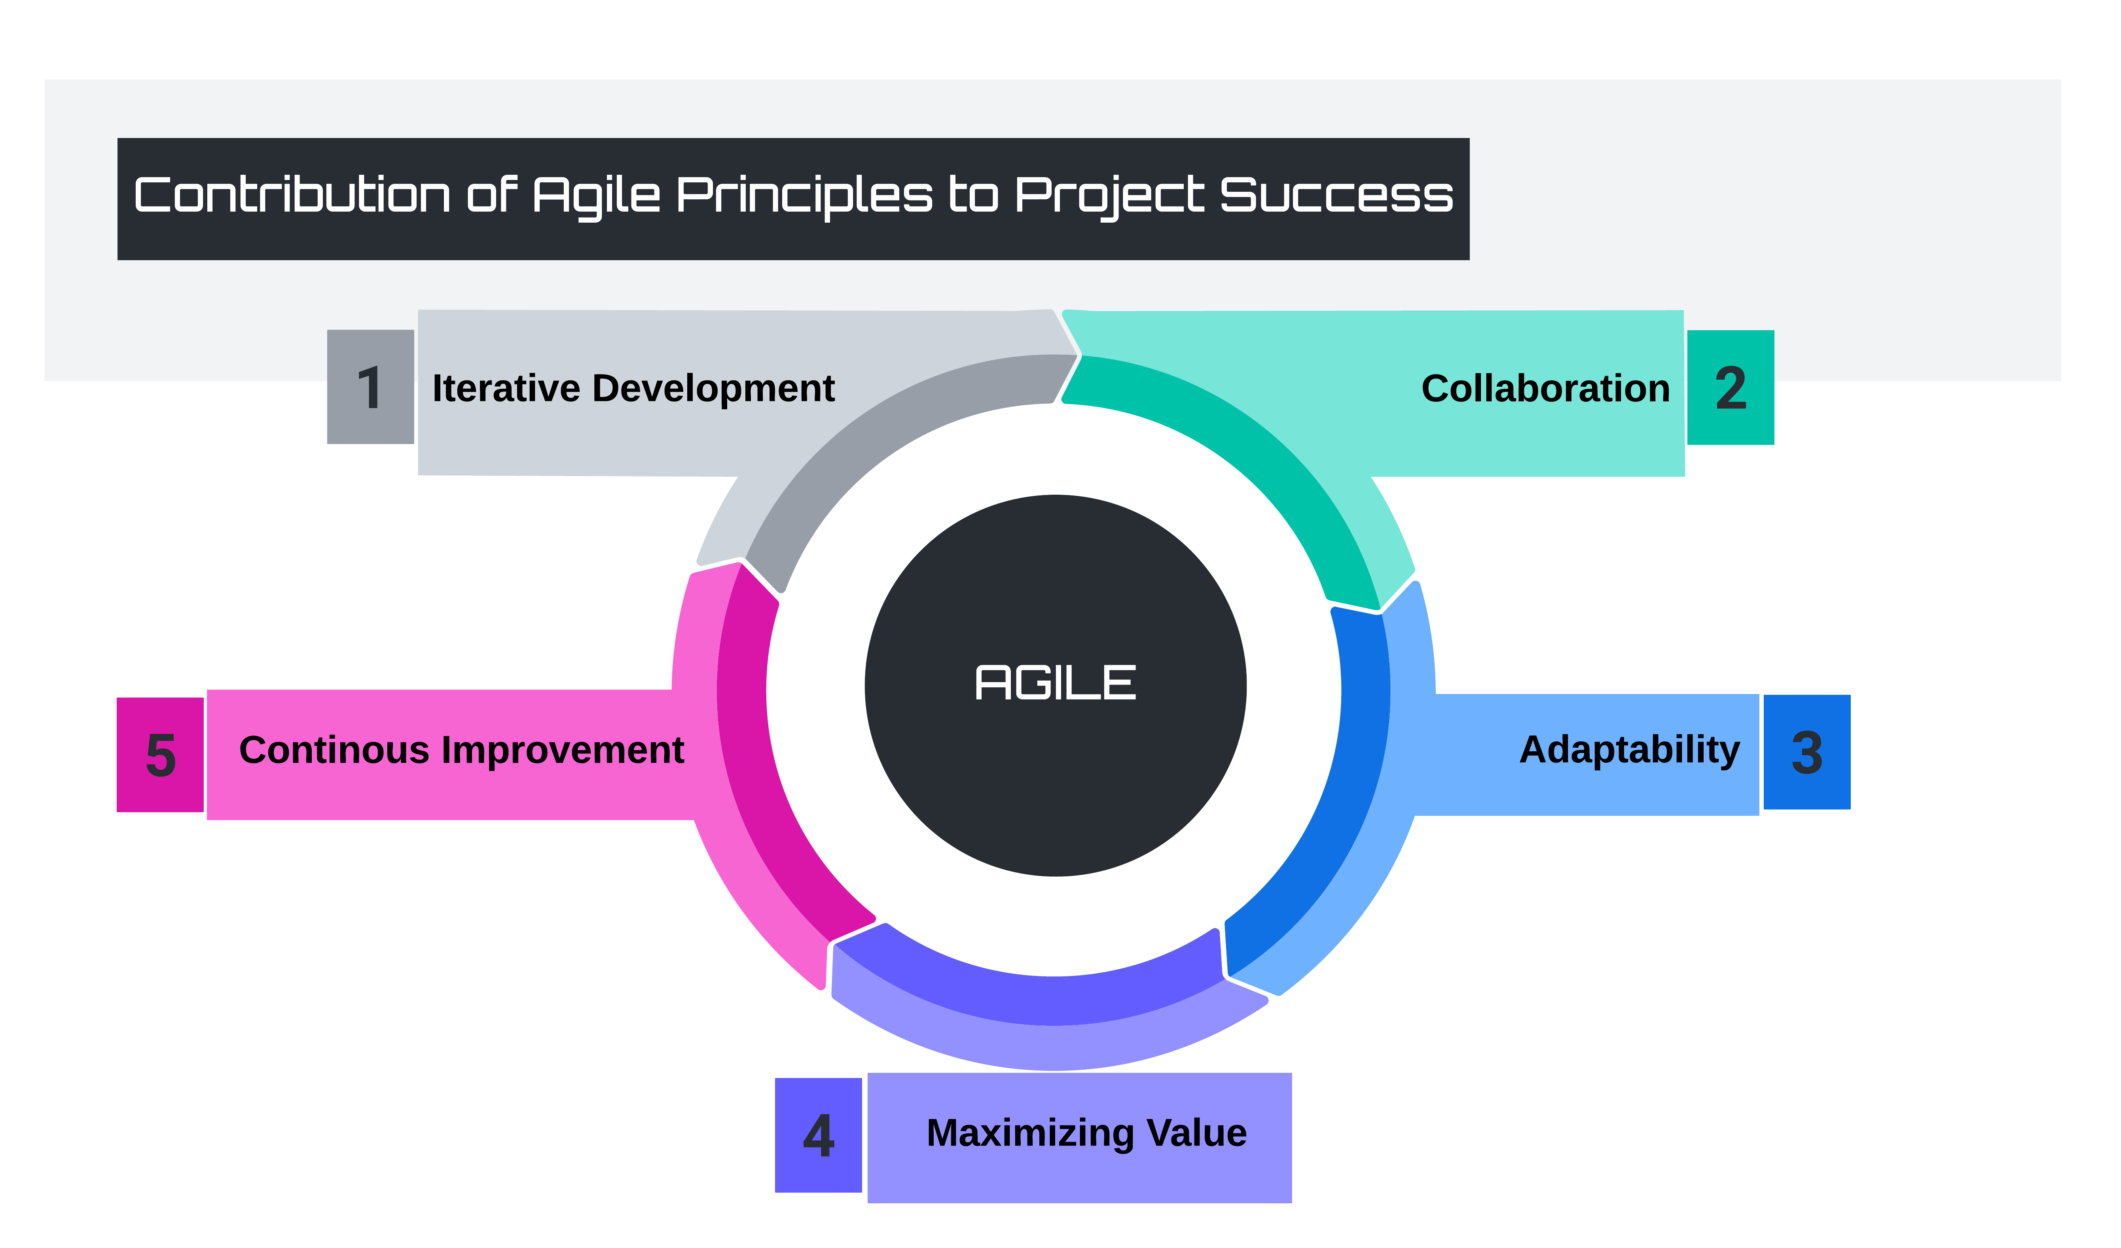
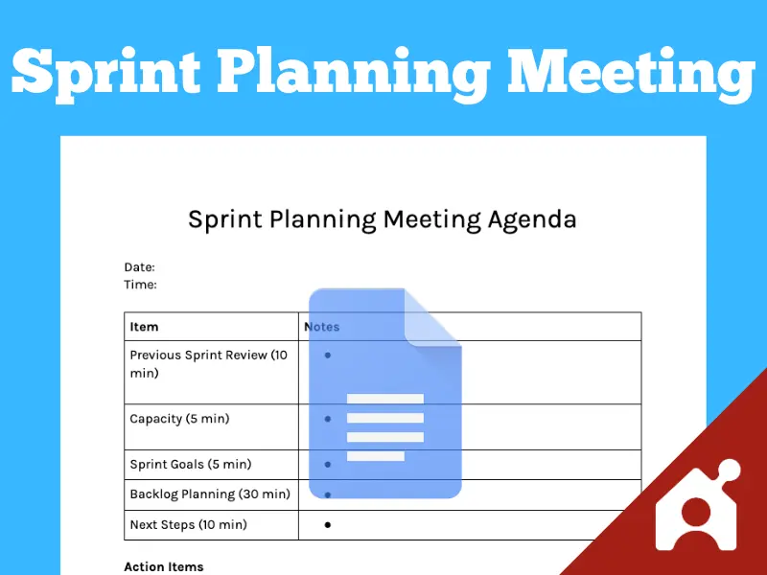
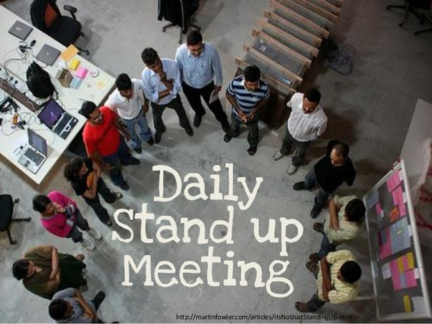
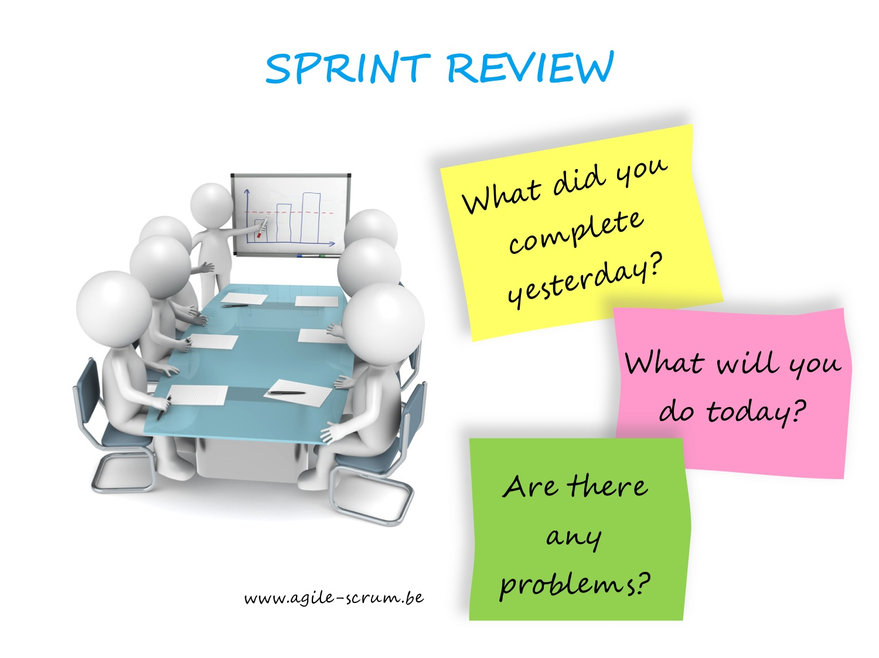

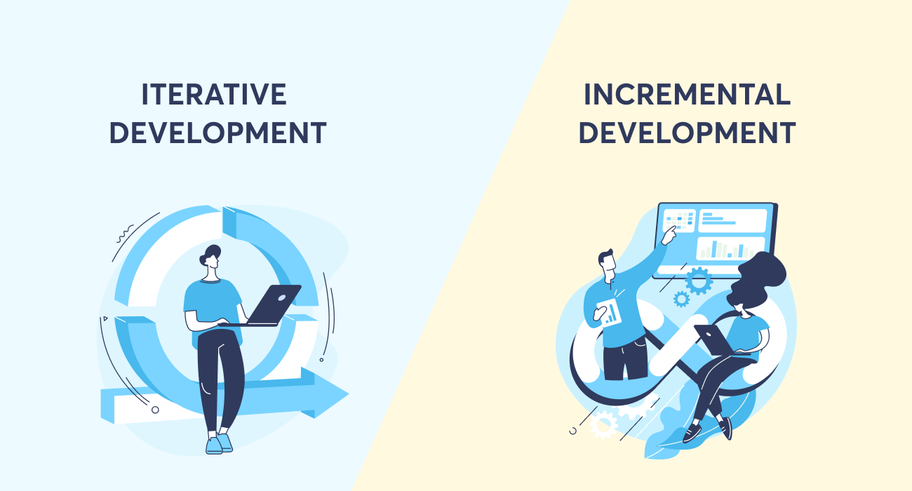
Reflect on the Agile Process
Notes:
The use of Agile methodology in the Heritage Centre Arboretum Development Project proved to be highly effective. Regular stand-ups, collaborative planning, and frequent reviews facilitated clear communication and alignment among stakeholders. Agile principles of iterative development, collaboration, adaptability, maximizing value, and continuous improvement were integral to the project's success, allowing it to adapt to changes and deliver meaningful outcomes

Slide 5
Discuss Challenges and Solutions
Stakeholder management
Volunteer Coordination
Adapting to Changes
Balance between Value and Simplicity
Putting into Practice Quick feedback
Resource Allocation
Maintaining Sustainable Pace
Collaborative Planning
Progressive Deliverables
Resolution of Conflicts

Slide 6
Team Collaboration and Individual Contributions
Effective Communication
Collaboration
Shared Responsibilities
Team member | Contribution
Gaurav Saraswat | Reasons for Agile Planning and management Communication challenges, personas creation Improvement Actions and Definition of Done
Indrani Bothsa | Stakeholder management, Sustainable pace for the project Decision making responsibilities, Effectiveness with Agile Concepts Budgeting and Donation Management
Vaishnavi Wadhwa | MVP, Agile Principles Backlog Creation, Release planning Risk Assessment and Value Addition
Neha Singh | Vision Statement, Product Roadmap Activity Prioritisation, Story Selection ,Work Estimation Risk Response plans and Critical Risks

Slide 7
Evaluate Project Goals
Achieve Level One Arboretum Status
Encourage Community Participation and Environmental Education
Expand Heritage Center's Rental Opportunities

Slide 8
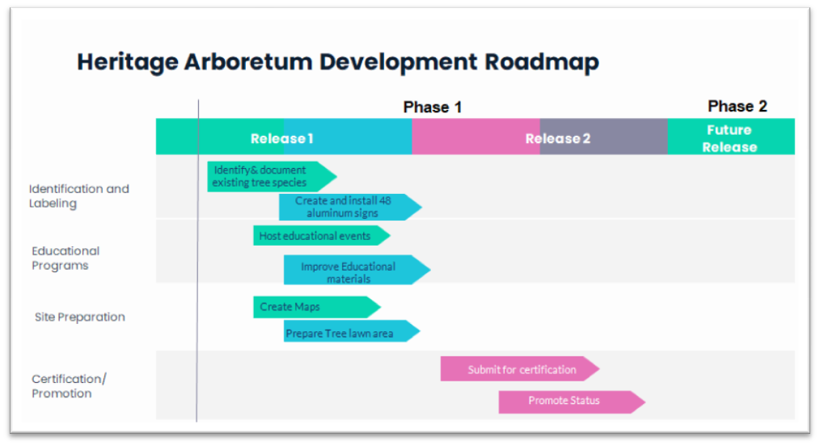
Future Recommendations

Slide 9
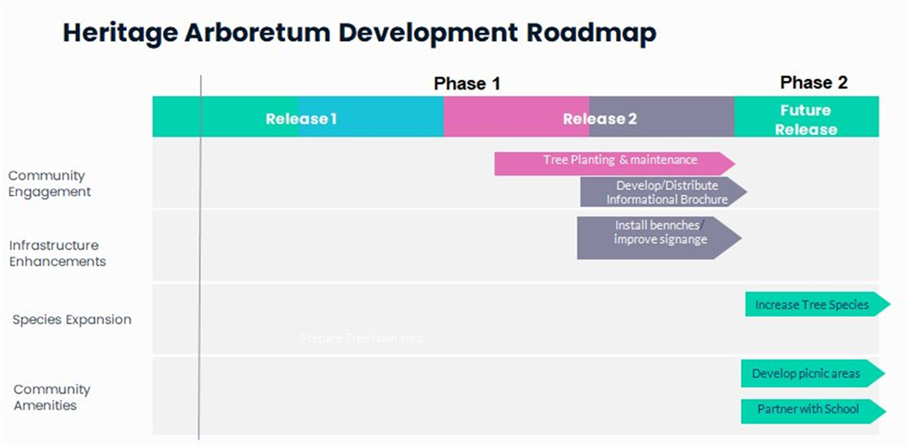
Future Recommendations

Slide 10
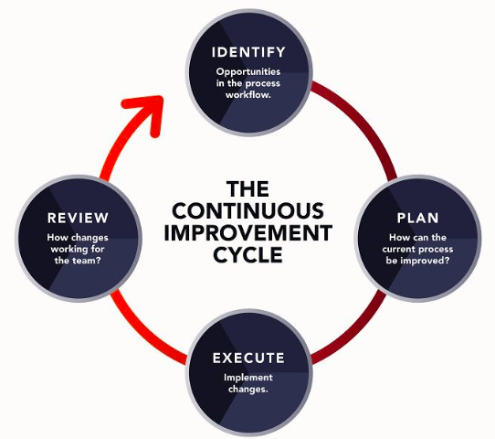
Future Recommendations

Slide 11
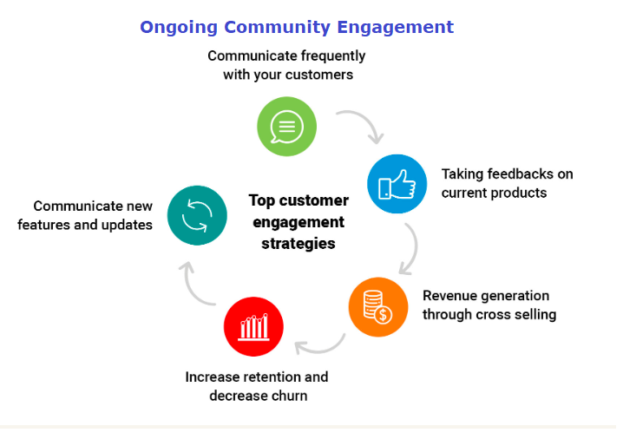
Future Recommendations

Slide 12
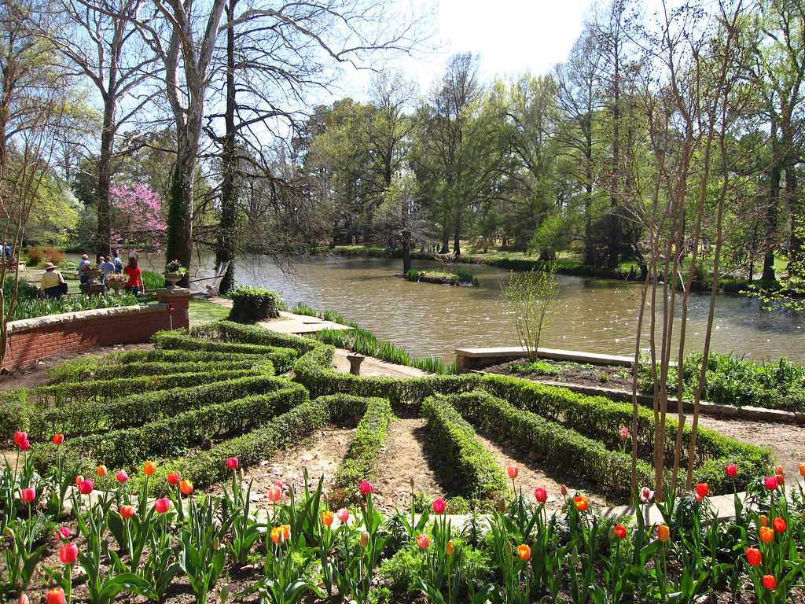
Conclusion & Closure
Due to the execution of the Heritage Arboretum Development Project and its alignment with the outlined objectives, the following benefits were realized. Certification at the level one Arboretum, Boost in community engagement and conservation, Increase in rental prospects, and the application of the Agile planning model. The following successes improved the educational and recreational function of the Heritage Centre, which helped to promote its sustainability.

Slide 13
References
Conestoga College. (2024). Heritage Arboretum Development Project Part 3.pdf
https://conestoga.desire2learn.com/d2l/common/viewFile.d2lfile/Database/MTM5MzEyNTk3/Heritage%20Arboretum%20Development%20Project_Part%203.pdf?ou=1123618
Lucidchart. (2024). Cycle Diagram. Template
https://lucid.app/lucidchart
Group 1. (2024a, June 18). S24_Group-1__MGMT8666_Report_Group Project 1. PDF
S24_Group-1__MGMT8666_Report_Group Project 1.pdf
Group 1. (2024b, July 09). S24_Group-1__MGMT8666_Report_Group Project 2. PDF
S24_Group-1__MGMT8666_Report_Group Project 1.pdf
Group 1. (2024c, July 28). S24_Group-1__MGMT8666_Report_Group Project 3. PDF
S24_Group-1__MGMT8666_Report_Group Project 1.pdf

Slide 14

Thank you for listening.
Your time and interest mean a lot to us.

